Slide 1

CMR TECHNICAL CAMPUS Accredited by NBA, Approved by AICTE, affiliated to JNTUH Kandlakoya (V), Medchal Road, Hyderabad -501401
DEPARTMENT OF COMPUTER SCIENCE AND ENGINEERING
A
Major Project
on
Image to Recipe Prediction System
Under the guidance
K. Ranjith Reddy GROUP NAMES
J. Krishna Mohan (187R1A05F1)
K. Jayanth (187R1A05F2)
K. Sagar (187R1A05F5)

Slide 2
CONTENTS:
Abstract
Existing System
Disadvantages
Proposed System
Advantages
Software Requirements
Hardware Requirements
Architecture
Modules Description
UML Diagrams
Conclusion

Slide 3
ABSTRACT:
People appreciate food and enjoy food photography. So, they post food images on social media platforms like Instagram. Behind each flavorful bite, there is an unspoken narrative illustrated in a recipe. Unfortunately, just through a glance at the food image, we are unable to understand the approach to its preparation procedure. In this project, we have introduced a Reverse Cooking system that revives the cooking recipes in the form of recipe names, ingredients, and cooking procedures from the inputted food image. The entire model is evaluated on a large-scale Recipe dataset and generates highly accurate predictions by leveraging the food image.
A key challenge may pose during this model building as dishes of distinct cuisines may look similar regarding their cooking procedures. To solve this, the model has been trained using Convolutional Neural Networks to categorize the food images into various categories and output a matched recipe. Combining it with a high-level classifier improves retrieval performance. To summarize, the model works on automated image recognition over a photographed dish and the output of the matched recipe subsequently.

Slide 4
EXISTING SYSTEM:
In the existing system for reverse cooking , methods and algorithms are not that much accurate in classification. In general in existing systems classification are ANN due to accuracy dependency of quality of classifications.
The existing system takes inputs as text format.

Slide 5
DISADVANTAGES:
The main disadvantages of using ANN is significantly slower due to an operation such as Maxpool. As ANN has several layers then the training process takes a lot of time in image processing, if the computer doesn’t consist of a good GPU.

Slide 6
PROPOSED SYSTEM:
To overcome the drawbacks of the methods we have reviewed above, we propose a new model. In this model we combine many techniques to reach our final goal of Image to recipe prediction. The steps for the process are listed below:
1.Retrieval of Data
2.Data Cleaning
3.Image Encoder
4.Ingredients Decoder
5. Cooking Instruction Decoder
6. Estimation of Accuracy and loss.

Slide 7
ADVANTAGES:
The Convolutional Neural Networks (CNN or ConvNet) are complex feed forward neural networks. CNNs are used for image classification and recognition because of its high accuracy.
The main advantage of CNN compared to its predecessors is that it automatically detects the important features without any human supervision.
CNN is also computationally efficient.

Slide 8
Software Requirements:
Operating System : Windows 7/8/10
Technology : python 3.7 (64 bit) & Required Packages

Slide 9
Hardware Requirements:
Processor - I3/I5/I7 Intel Processor
RAM - 4GB (min)
Internal Memory - 12GB
Internet Connection - Mobile Internet/ WIFI-Enabled.

Slide 10
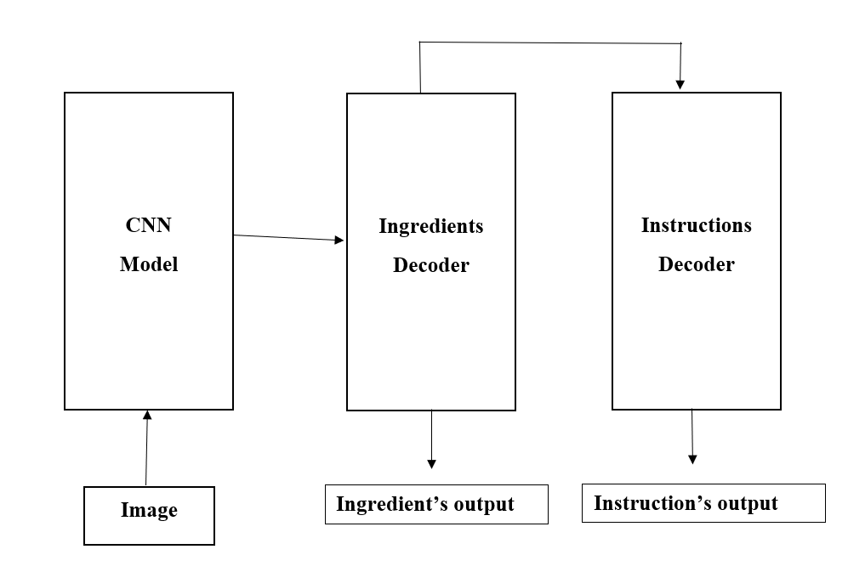
Architecture :

Slide 11
Modules Description: Module 1: Data Cleaning
• Removal or replacement of Special symbols (such as @, ! , -, *,) with blank spaces.
• Handling Compound words: When two or more words are concatenated to form a new word that has a completely different definition.
• Splitting into multiple ingredients: Ingredients with no compound words were tokenized into multiple words, retaining only nouns.
• Computation of occurrence of Ingredients: The number of occurrences for each Ingredient present in the dataset was calculated and stored in the stem variable.
• Removal typo errors: As most of the recipes were taken from cooking blogs and website on the Internet, typing errors were abundant in the dataset.
• Image Scrapping, Image resolution.

Slide 12
MODULE 2: Pre-processing the Dataset
We begin with importing the libraries that would be required to perform certain tasks in the code.
import pandas , numpy .
The entire dataset is split into Training Set, and Validation Set, and Test Set of similar distribution. A 60-20-20 split was performed on the existing dataset into three categories as follows:
Training Set
Test Set
Validation Set

Slide 13
MODULE 3: Building CNN Model
The most preferred VGGNet was designed by Visual Geometry Group and stood as the runner-up in the ImageNet competition as the most effective Feature extraction model. Inspired from the VGG-16 model which is 16 hidden layers and pre-trained on more than 27 one million images of around 1000 objects from the ImageNet database, we have built a model of the same architecture for ingredient recognition for the food image.
Implementation of CNN in Reverse cooking manner:
Convolutional layer
Max Pooling
Flattening
Full connection

Slide 14
MODULE 4: Image Encoder
Generally, Encoder takes a variable-length input sequence and then transforms it into fixed-size output.
Here, the image encoder maps an input image image into a feature representation X which consists of the number of image features and the embedding dimension.
Upon image data encoded to an integer, the embedding layer represents each word in the form of a unique numeric value.
Typically, the decoder maps the encoded output of a fixed length to a variable-length sequentially by taking inputs and generating outputs at each intervals of time.

Slide 15
MODULE 5: Ingredients Decoder
It is a transformer decoder network that is conditioned on the image features x to produce feature vectors denoting the number of ingredients.
The decoder output of the will be inputted to a linear output layer followed by a SoftMax activation function to generate the predictions.
SoftMax activation ensures that the output probabilities sum up to 1.

Slide 16
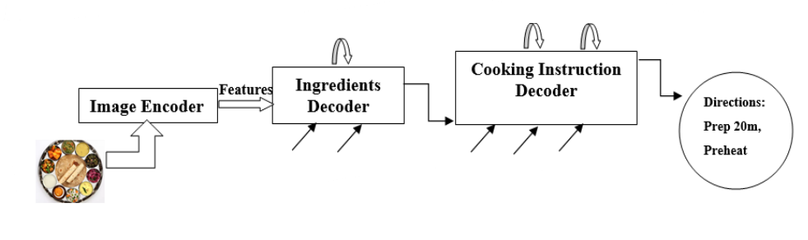
MODULE 6: Cooking Instructions Decoder
The output of the Ingredients decoder is given to the cooking instruction decoder for the generation of food recipes.
It is conditioned on both the embedded image and the ingredients features x obtained from the Ingredients decoder.

Slide 17
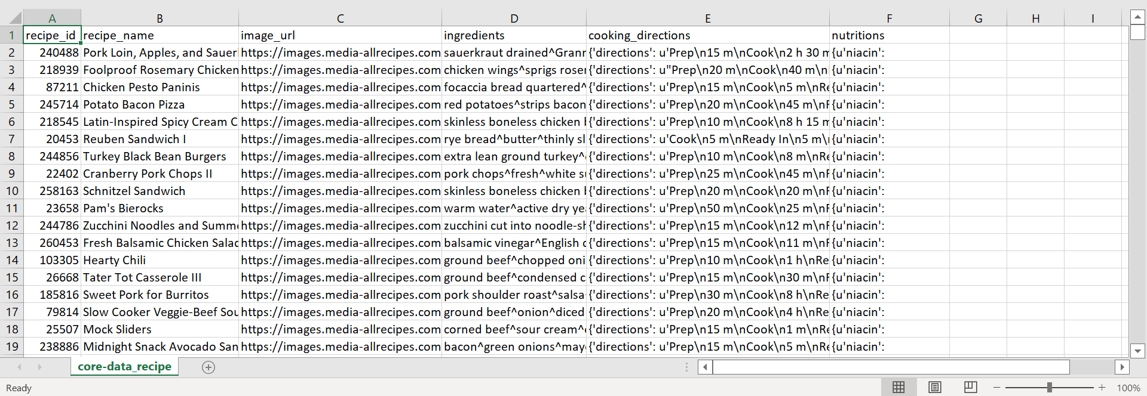
Dataset:

Slide 18
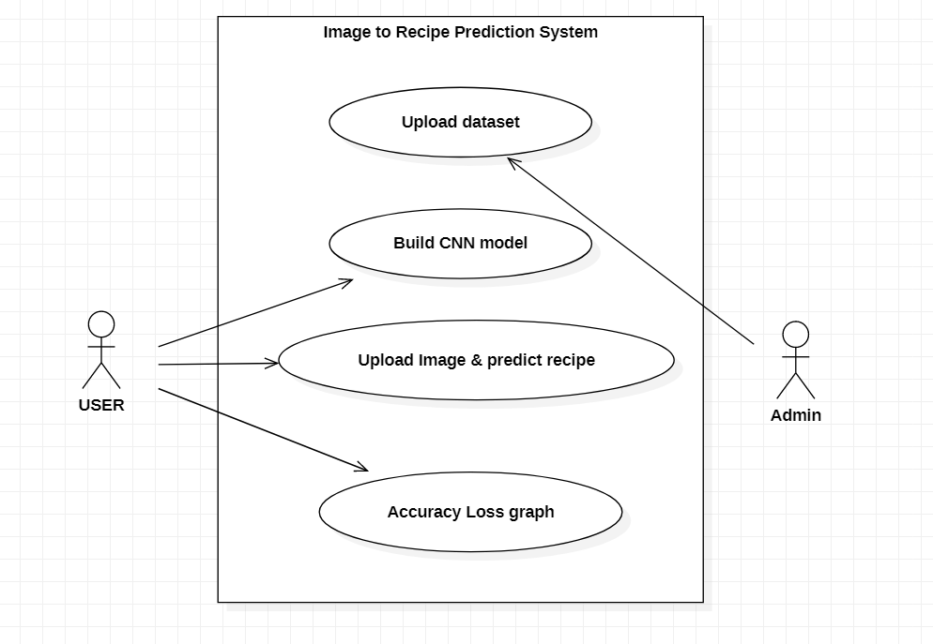
UML Diagrams : Use Case Diagram

Slide 19
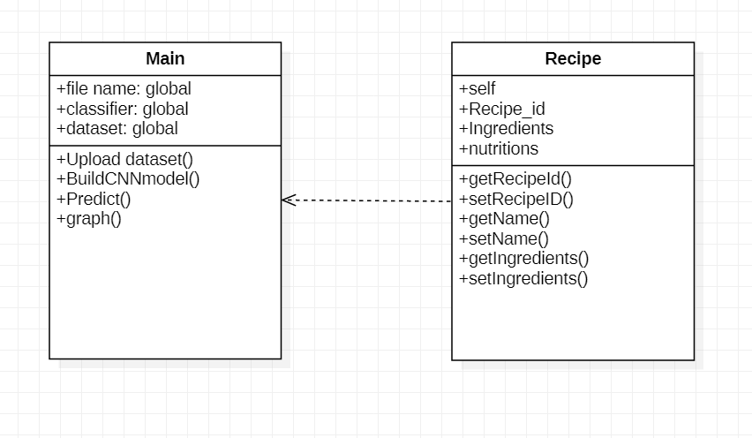
Class Diagram :

Slide 20
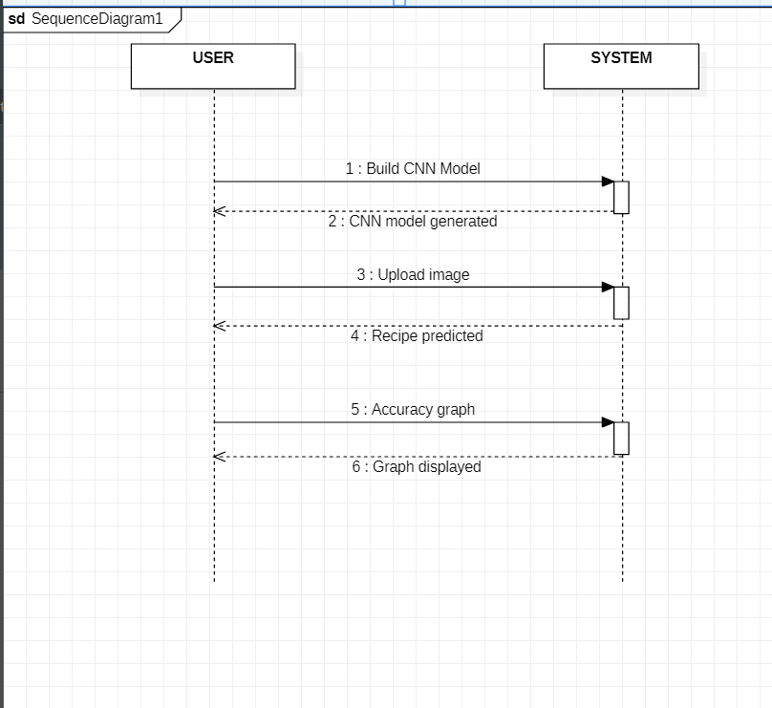
Sequence Diagram:

Slide 21
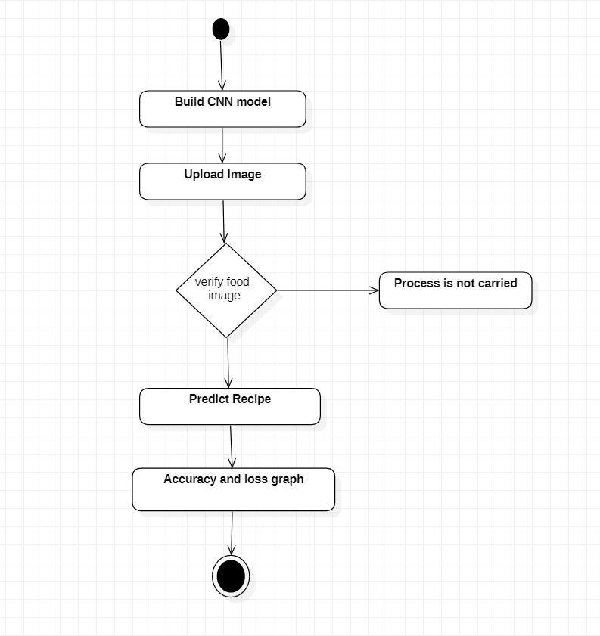
Activity Diagram:

Slide 22
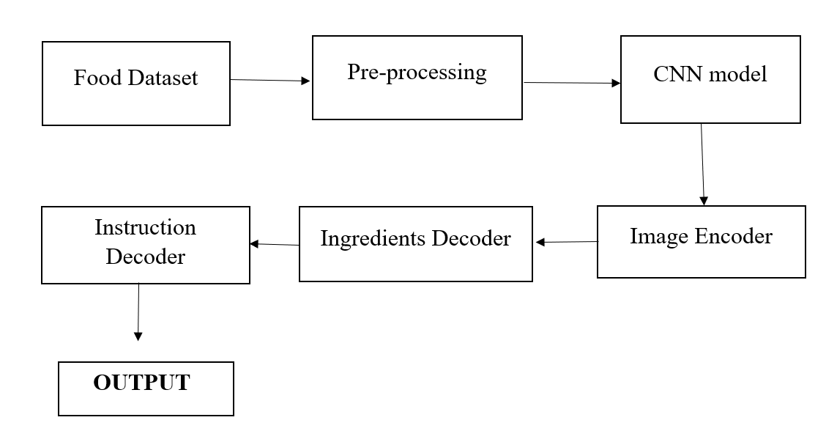
Data Flow Diagram:

Slide 23
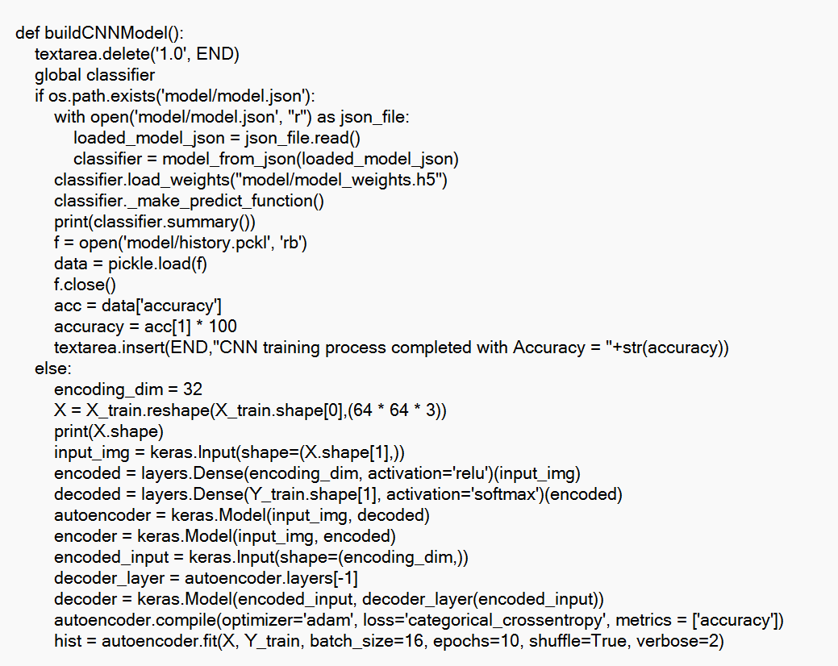
Sample code:

Slide 24
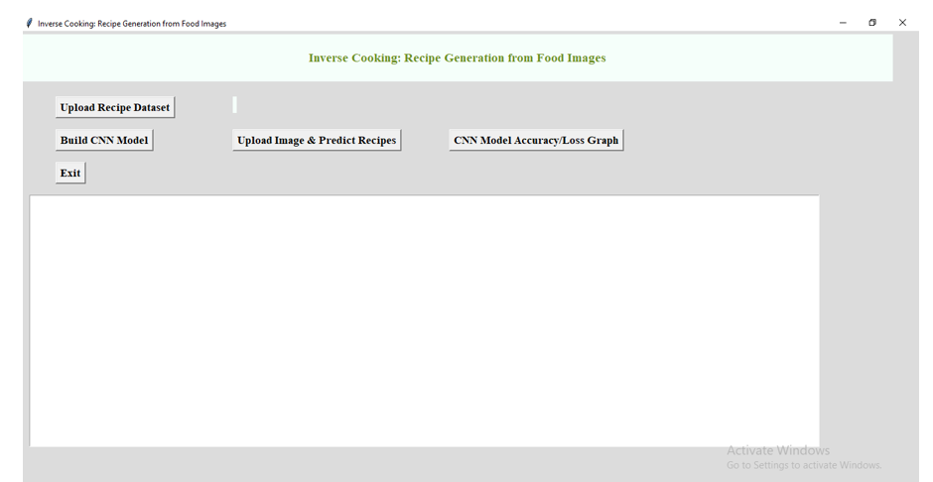
Output1 :

Slide 25
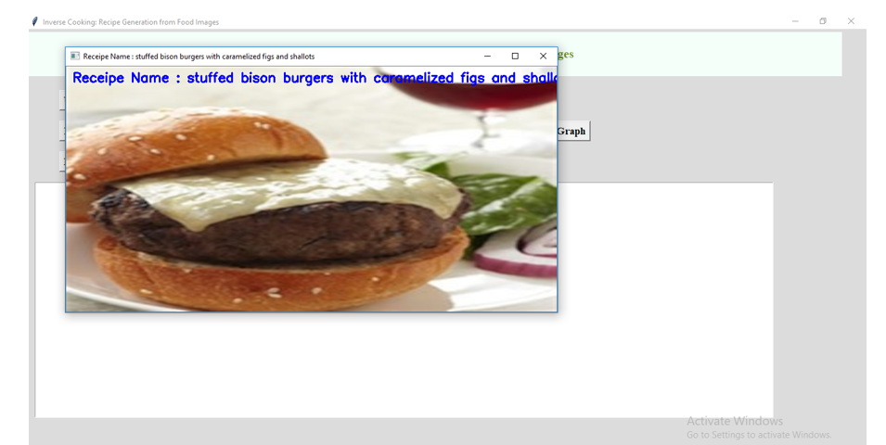
Output 2:

Slide 26
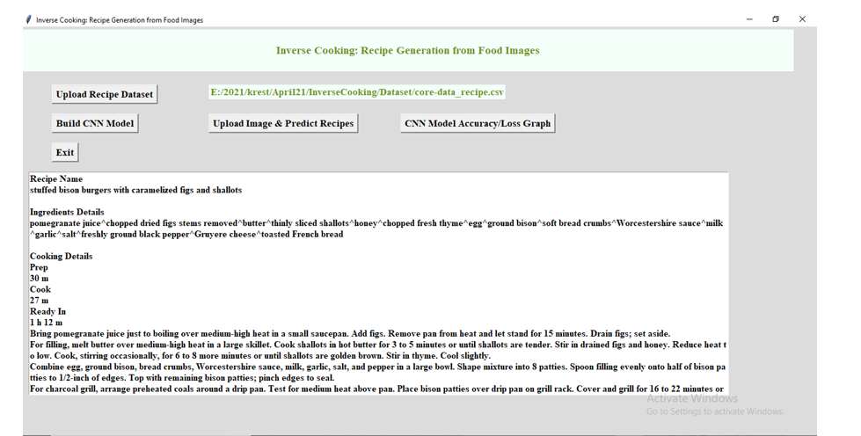
Output 3:

Slide 27
CONCLUSION:
In this we have presented a Food ingredient recognition and cooking Recipe prediction model. Cooking Recipes are quickly predicted and displayed upon inputting a food image obtained directly from web sources. This is a unique model that incorporates visual object detection into the culinary recipe recommendation system.

